Slide 1

Public Transportation Efficiency Analysis
Welcome to the presentation on Public Transportation Efficiency Analysis. In this project, we have explored various aspects to understand and enhance the efficiency of public transportation systems. Let's dive into the details!

Slide 2

Code Of Conduct
Introduction To Data
IBM Cognos Integration and Dashboard
Data Manipulation

Slide 3

Data Sourcing
To ensure accurate and comprehensive analysis, we have employed web scraping and API calls to gather real-time data on public transport schedules and delays. Additionally, we have considered incorporating data from GTFS feeds, which provide detailed information on public transport routes and stops.
In order to gain a holistic view of the public transport landscape, we have also explored open data initiatives from local government and transportation agencies, which have provided us with additional relevant data for our analysis.

Slide 4



External Features
Weather Data Analysis
Event Data Integration
Demographic Considerations
By incorporating weather data into our analysis, we can better understand the impact of weather conditions on public transport efficiency. This enables us to identify patterns and potential disruptions influenced by adverse weather.
Analysing demographic data helps us gain insights into commuter patterns and identify potential congestion points. By understanding the population density and distribution, we can optimize public transport routes and services accordingly.
We have also considered incorporating event data, such as concerts and sports events, into our analysis. These events can significantly impact public transport demand, and understanding their effect allows us to make informed decisions regarding service allocation and scheduling.

Slide 5

IBM Cognos Integration
As part of our advanced reporting and data analytics capabilities, we have integrated IBM Cognos into our project. Cognos enables us to leverage its powerful features for insightful analysis and reporting.
By utilizing Cognos, we can create interactive dashboards that allow for dynamic exploration of public transport data. This empowers users to gain deeper insights and make data-driven decisions.

Slide 6
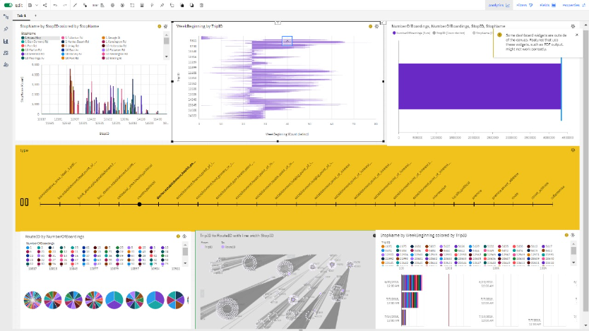
Interactive Dashboard Creation
Filters and Drop-Down Menus
Interactive Charts
Drill-Down Functionality
We have incorporated interactive charts and graphs, which allow users to engage with the data and explore different visual representations. This fosters a deeper understanding of public transport efficiency.
Our dashboard includes drill-down functionality, which provides users with detailed insights when they click on specific elements. This enables them to delve into granular information and uncover valuable insights.
Users can easily filter and narrow down the data based on their specific interests and requirements. This allows for a more personalized and tailored analysis.

Slide 7
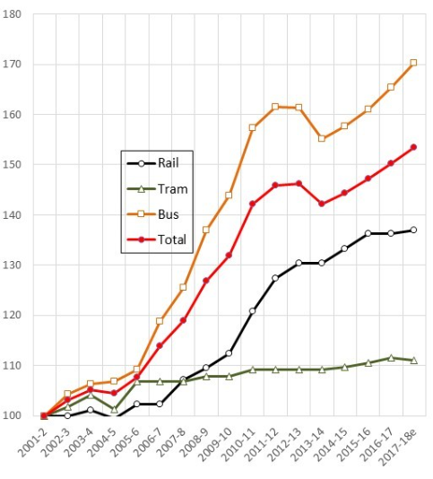
Data Aggregation
In order to identify patterns and trends, we have aggregated our data by different time intervals, such as hourly and daily. This allows us to analyze the efficiency of public transport systems at various scales.
Furthermore, we have also explored spatial aggregation, which helps us analyze transport efficiency in different regions or districts. This enables us to identify specific areas where improvements and optimizations can be made effectively.
Data aggregation is the process of collecting and summarizing information from multiple sources into a cohesive dataset, enabling meaningful analysis and insights for various purposes.

Slide 8
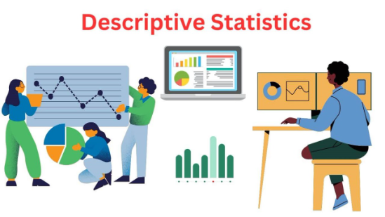
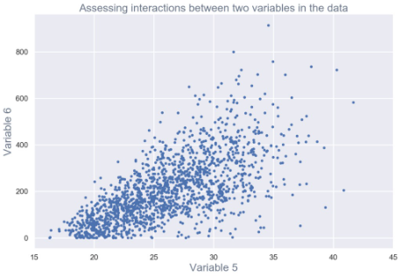
Data Exploration
Descriptive Statistics and Visualization
By utilizing descriptive statistics and visualization techniques, we gain valuable insights into the distribution and characteristics of our data. This enables us to identify outliers, trends, and other key features that drive public transport efficiency.
Correlation Analysis
Exploring correlation analysis allows us to understand the relationships between different variables, such as weather conditions and delays. This helps us identify factors that have a significant impact on public transport efficiency.

Slide 9
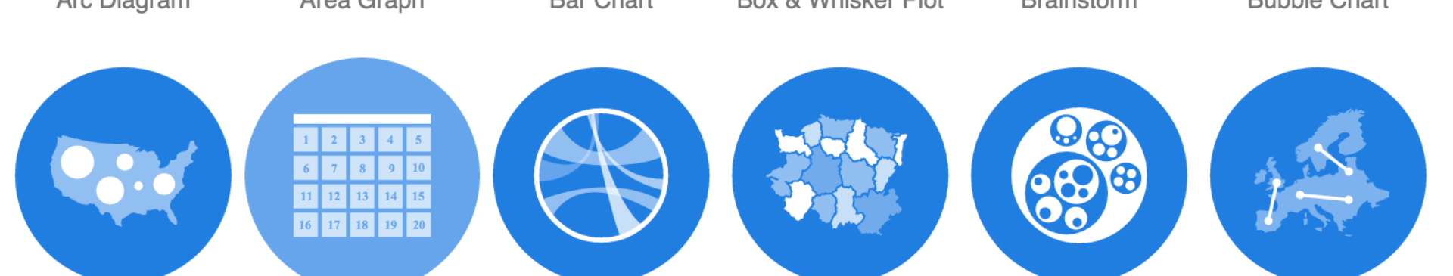
Data Visualization
In order to effectively communicate our findings, we have utilized tools like Tableau and Power BI to create informative and visually appealing charts and graphs. These visualizations provide a clear representation of the data and facilitate better decision-making.
We have also used heatmaps to highlight congestion areas and time periods with high delays. By visually representing this information, we can focus our efforts on improving those specific areas.
Furthermore, we have explored network visualization techniques to represent public transport routes and connections. This allows us to better understand the complexity and interdependencies within the system.

Slide 10
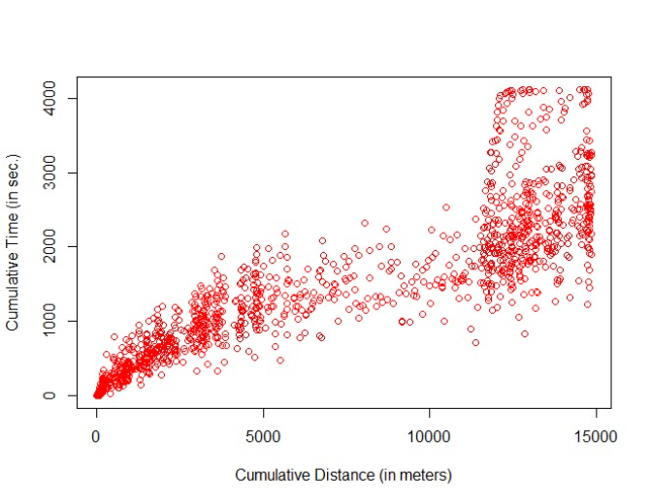
Data Pre-processing
Prior to analysis, we have applied various techniques to ensure the quality of our dataset. This includes data cleaning, outlier detection, and missing value imputation.
In addition, we have considered feature scaling and normalization to prepare the data for machine learning algorithms. These techniques help us standardize the data and improve the accuracy of our models.

Slide 11
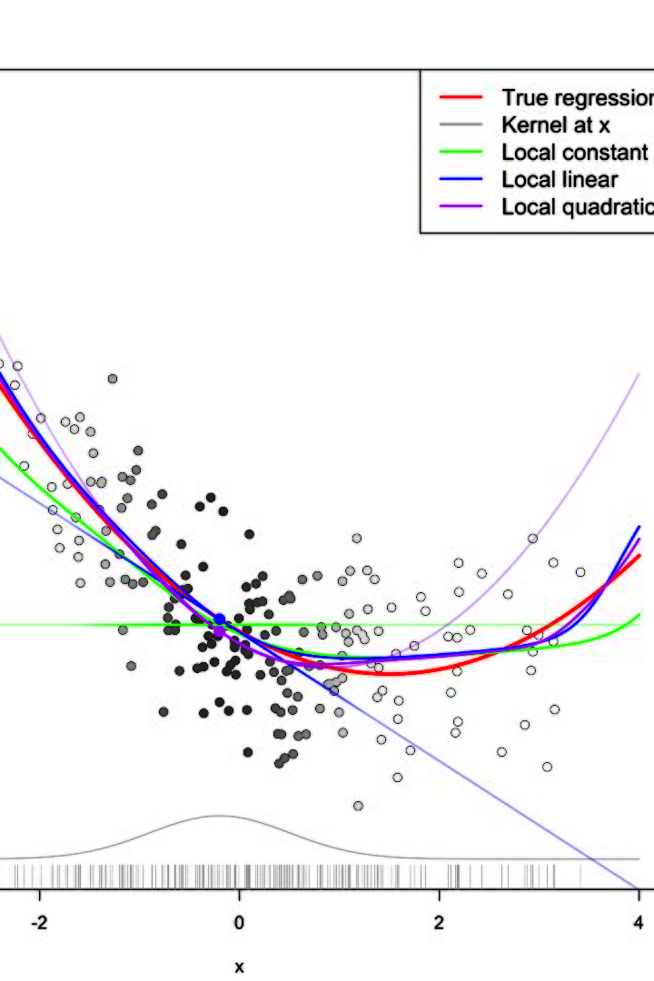
Predictive Modeling
We have employed regression models to predict factors like travel time, delays, and passenger load. By leveraging historical data and relevant variables, these models provide valuable insights that can be used to optimize public transport efficiency.
Additionally, we have utilized time series analysis techniques to forecast future demand and identify potential bottlenecks. This enables us to proactively address issues and ensure smooth operations.

Slide 12
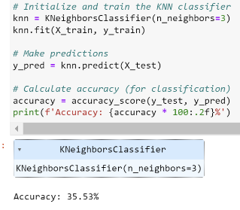
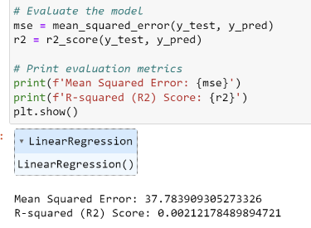
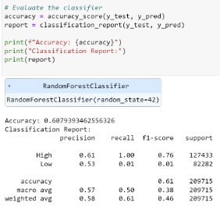
Machine Learning Algorithms
KNN
Linear Regression
Random Forrest
K-nearest neighbours (KNN) is a simple yet effective machine learning algorithm for classification and regression tasks. It assigns labels or predictions based on the majority vote of its K nearest data points.
Linear regression is a fundamental statistical method used to model the relationship between a dependent variable and one or more independent variables. It's widely employed in predictive modelling and data analysis.
A Random Forest Classifier is a powerful machine learning algorithm that combines multiple decision trees to make accurate predictions and classify data in various fields, such as finance and healthcare.

Slide 13
In Summary
1
Comprehensive Analysis
2
Data-Driven Decision Making
3
Optimizing Efficiency
Our findings and insights contribute to the optimization of public transport services, leading to smoother operations, reduced congestion, and improved overall efficiency.
Our project covers various aspects of public transportation efficiency analysis, including data sourcing, exploration, visualization, predictive modeling, and advanced reporting.
By leveraging data and incorporating advanced analytics techniques, we enable evidence-based decision-making in improving public transportation systems.

